Slide 1
OOPS

Slide 2
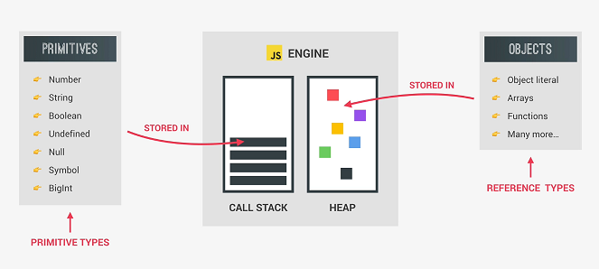
Datatypes:

Slide 3
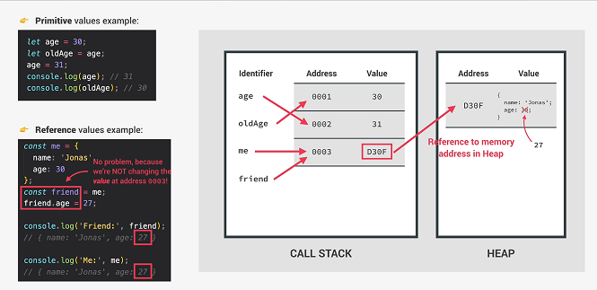
Primitive vs Reference Types

Slide 4
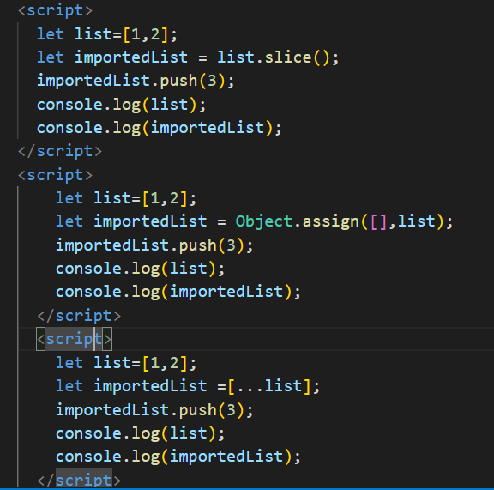
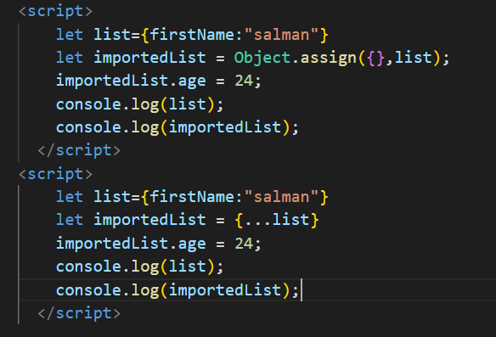
Deep copy of Array and Object

Slide 5
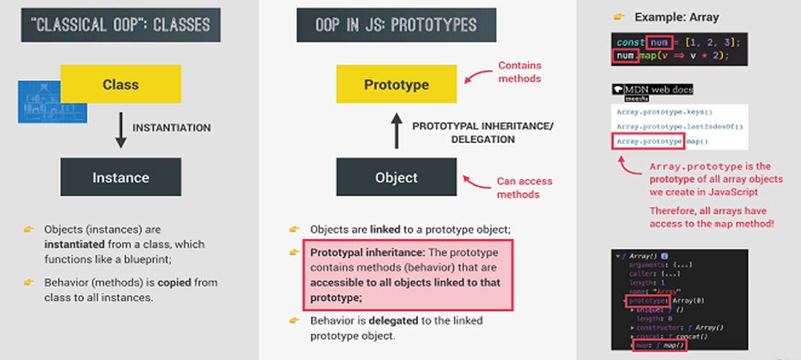
OOPS in Javascript

Slide 6
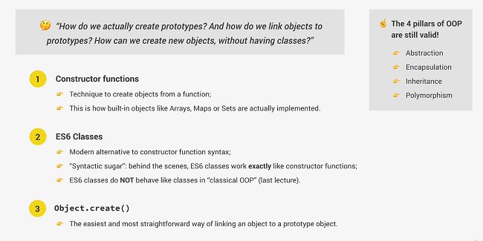
3 Ways of Implementing Prototypal Inheritance in Javascript

Slide 7
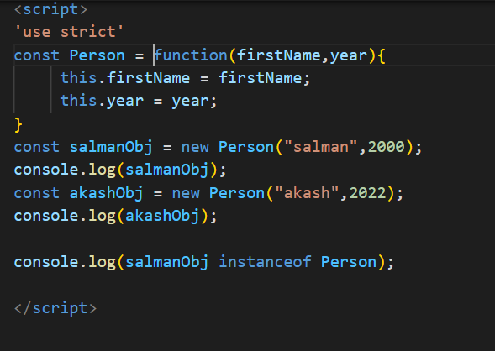
1.Constructor Function

Slide 8
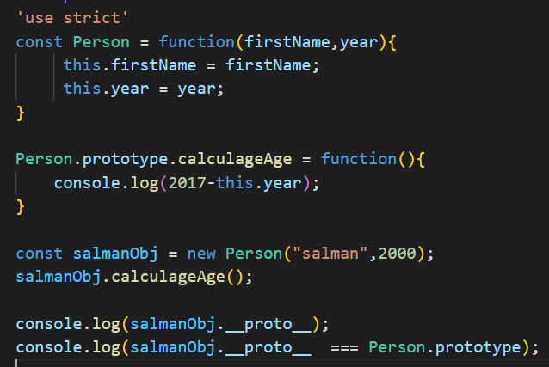
Prototypes

Slide 9
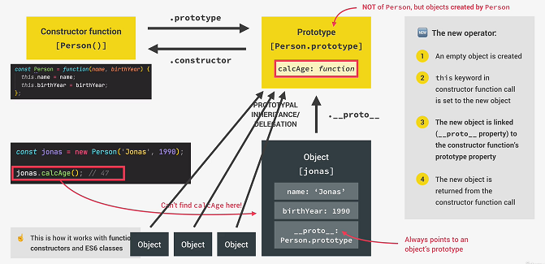
How Prototypal Inheritance

Slide 10
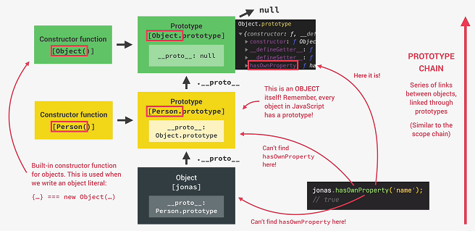
Prototype Chain

Slide 11
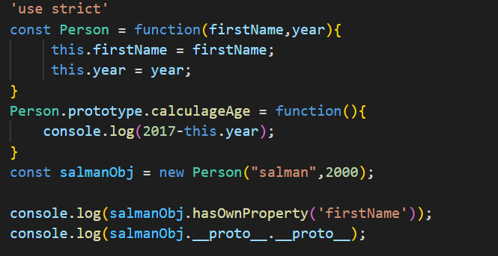
Prototypal Inheritance on Built in Objects

Slide 12
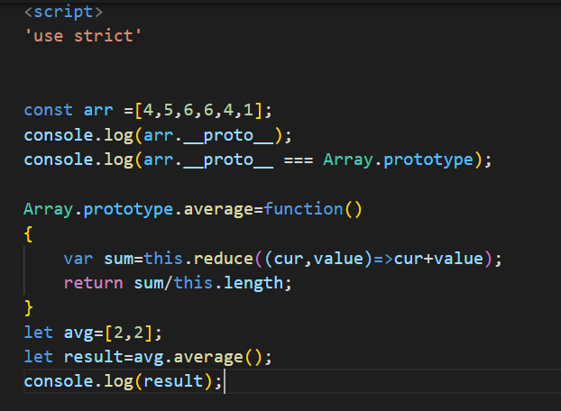
Prototypal Inheritance on Built in Objects

Slide 13
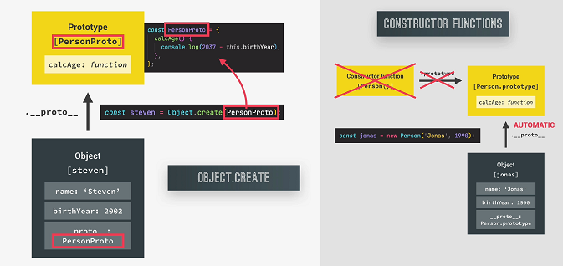
3.How Object.create Works

Slide 14
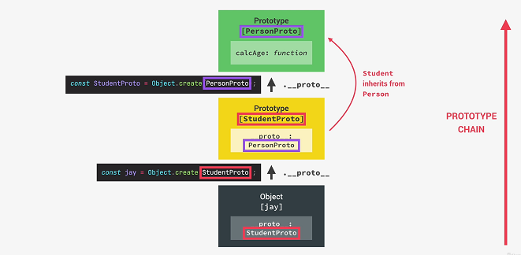
Inheritance in Object.create

Slide 15
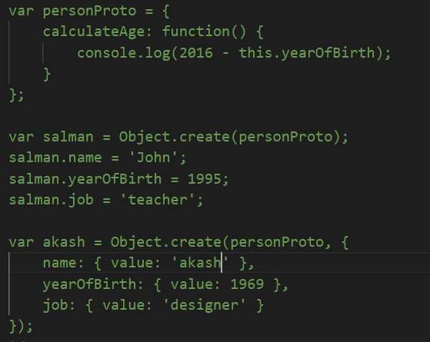
Inheritance – Object.create

Slide 16
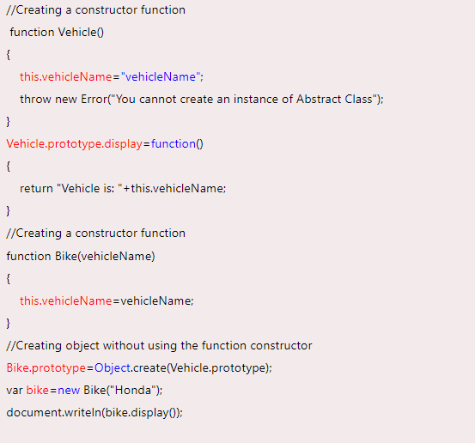
Abstraction

Slide 17
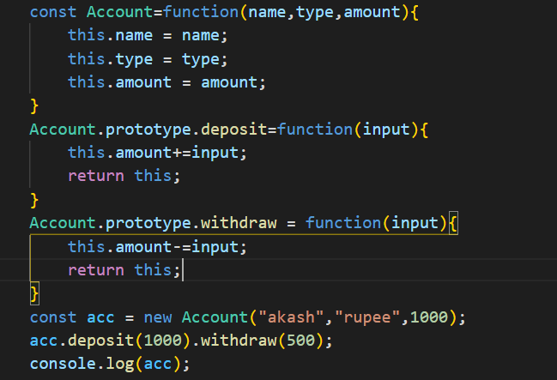
Chaining Methods

